Slide 1
Multithreading I
Lecture 27

Slide 2
Learning objectives
After the completion of today’s session you will be able to:
Describe the concept of Multithreading.
Illustrate the lifecycle of thread.
Explain the usage and types of thread.
Demonstrate the usage multithreading.

Slide 3
Introduction
Java provides built-in support for multithreaded programming.
A multithreaded program contains two or more parts that can run concurrently.
Each part of such a program is called a thread, and each thread defines a separate path of execution.
Thus, multithreading is a specialized form of multitasking.
However, there are two distinct types of multitasking:
Process-based and
Thread-based

Slide 4
Process VS Thread
A process is, in essence, a program that is executing.
Thus, process-based multitasking is the feature that allows your computer to run two or more programs concurrently. For example, process based multitasking enables you to run the Java compiler at the same time that you are using a text editor or visiting a web site.
In process-based multitasking, a program is the smallest unit of code that can be dispatched by the scheduler.
In a thread-based multitasking environment, the thread is the smallest unit of dispatchable code.
This means that a single program can perform two or more tasks simultaneously.
For instance, a text editor can format text at the same time that it is printing, as long as these two actions are being performed by two separate threads.
Thus, process-based multitasking deals with the “big picture,” and thread-based multitasking handles the details.

Slide 5
Advantages of multithreading
It doesn't block the user because threads are independent and you can perform multiple operations at the same time.
You can perform many operations together, so it saves time.
Threads are independent, so it doesn't affect other threads if an exception occurs in a single thread.
Java Multithreading is mostly used in games, animation, etc.

Slide 6
A single threaded program
class ABC
{
….
public void main(..)
{
…
..
}
}
begin
body
end

Slide 7
A Multithreaded Program
Main Thread
start
start
start
Thread A
Thread B
Thread C
Threads may switch or exchange data/results

Slide 8
Lifecycle of a Thread
Following are the stages of the life cycle:
New: When a new thread is created, it is in the new state. The thread has not yet started to run when the thread is in this state. It is also referred to as a born thread.
Runnable: A thread that is ready to run is moved to a runnable state. In this state, a thread might actually be running or it might be ready to run at any instant of time. It is the responsibility of the thread scheduler to give the thread, time to run
Blocked/Waiting: When a thread is temporarily inactive, then it’s in one of the following states:
Blocked
Waiting

Slide 9
Lifecycle of a Thread
Timed Waiting: A thread lies in a timed waiting state when it calls a method with a time-out parameter. A thread lies in this state until the timeout is completed or until a notification is received.
Terminated (Dead): A thread terminates because of either of the following reasons:
Because it exits normally. This happens when the code of the thread has been entirely executed by the program.
Because there occurred some unusual erroneous event, like a segmentation fault or an unhandled exception.

Slide 10
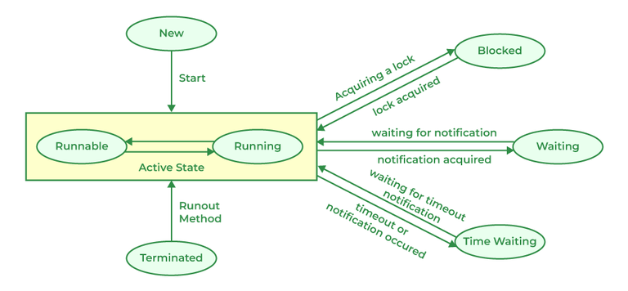
Lifecycle of a Thread

Slide 11
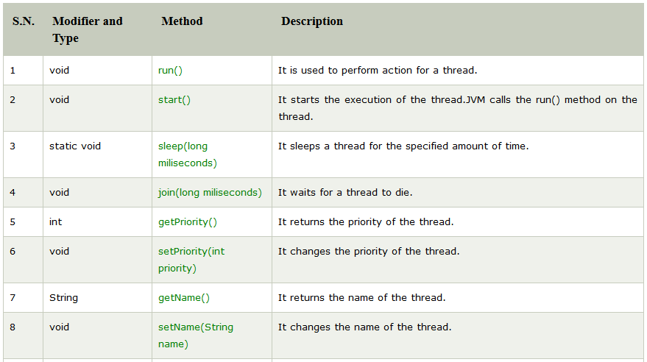
Thread Methods

Slide 12
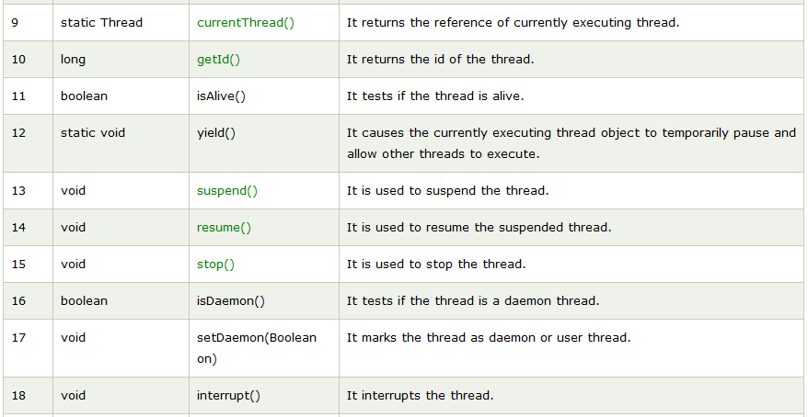
Thread Methods

Slide 13
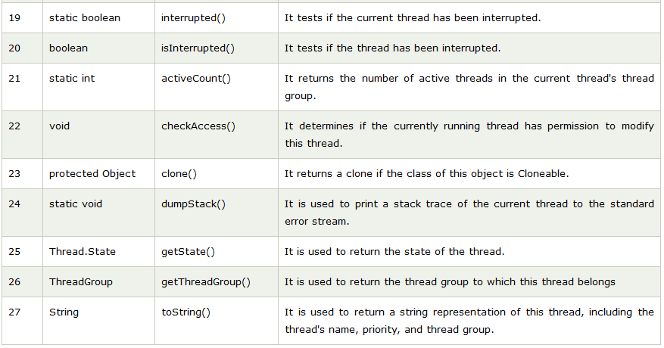
Thread Methods

Slide 14
Creating Threads
In the most general sense, you create a thread by instantiating an object of type Thread.
Java defines two ways in which this can be accomplished:
You can implement the Runnable interface.
You can extend the Thread class, itself.

Slide 15
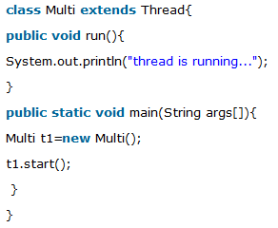
Java Thread Example by extending Thread class

Slide 16
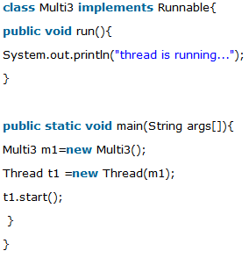
Java Thread Example by implementing Runnable interface

Slide 17
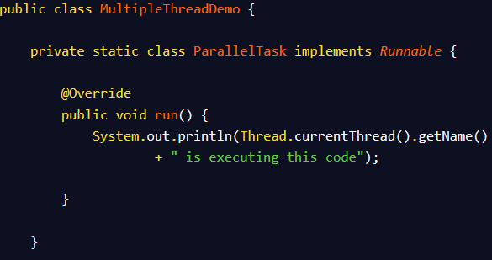
Running Multiple threads

Slide 18
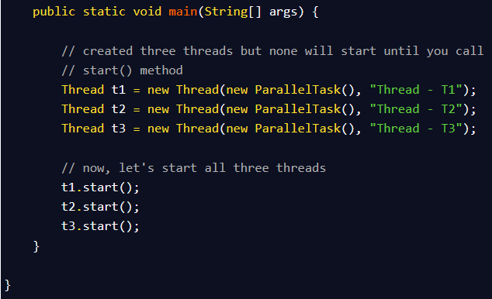
Running Multiple threads

Slide 19
Reference
https://www.geeksforgeeks.org/lifecycle-and-states-of-a-thread-in-java/
https://www.java67.com/2016/05/how-to-use-multiple-threads-in-java.html

Slide 20
Thanks

